Slide 1
College Management System
Group members:
N.Ishanth – 2510040002
K.V.Srinath – 2510030106
G.Abhishek – 2510040015
Ayian – 2510030309
Guidied by – Dr.A.Mahesh Babu sir

Slide 2
Core System Features
Dynamic Student & Course Management
Automated Admission Queue
Efficiently add, view, and manage student records and course catalogs using linked list data structures.
First-In-First-Out queue system for processing new student applications in the order they arrive.
Advanced Search & Analytics
Persistent Data Storage
Linear search by roll number and automated detection of students with low attendance below 75%.
File I/O operations ensure data persistence across application sessions with automatic save and load functionality.

Slide 3



System Architecture
The application follows a modular Model-View-Controller (MVC) pattern that separates concerns and promotes maintainability.
Controller Layer
CollegeManagementSystem manages the main menu loop and handles all user interaction and input processing.
Service Layer
CollegeOperations contains the core business logic including sorting algorithms, list manipulations, and data processing.
Model Layer
StudentNode and CourseNode define the data structure blueprints and relationships between entities.

Slide 4
Technical Stack & Data Structures
Primary Language
Key Technologies
Java - Object-oriented programming with strong typing and exception handling for robust application development.
File I/O for data persistence
Exception handling with try-catch blocks
Object-oriented design principles
1
Singly Linked Lists
Dynamic data structure for managing students and courses with efficient insertion and traversal operations.
2
Array-Based Queue
FIFO implementation for the admission system, ensuring applications are processed in chronological order.
3
Merge Sort Algorithm
Efficient O(n log n) sorting for student marks with stable sorting properties.
4
Quick Sort Algorithm
Fast O(n log n) average-case sorting for attendance percentages with in-place partitioning.
5
Linear Search
Direct lookup by roll number for O(n) student retrieval with immediate feedback.

Slide 5
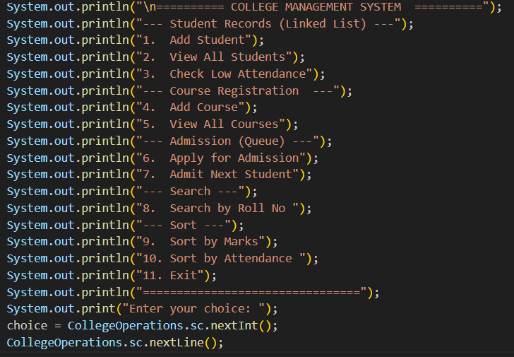
Student Management Operations
01
Add Student
Capture user input for roll number, name, marks, and attendance. Create new StudentNode and insert at the end of the linked list. Provide immediate success confirmation.
02
View All Students
Iterate through the linked list using a while loop (cnode != null). Display formatted student cards showing all fields with clear labels.
03
Identify Low Attendance
Filter students by checking if (cnode.attendance < 75). Generate a targeted list of students requiring academic intervention or counseling.
04
Search by Roll Number
Implement linear search through the list, comparing each node's roll number. Return full student details upon match or "Student not found" message.

Slide 6
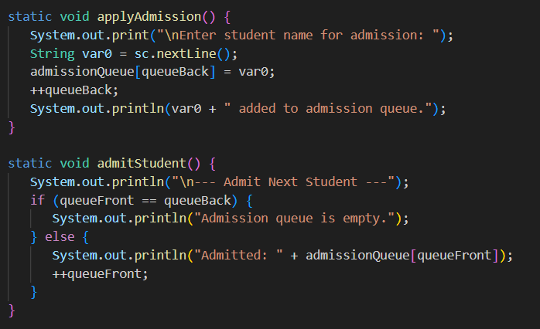
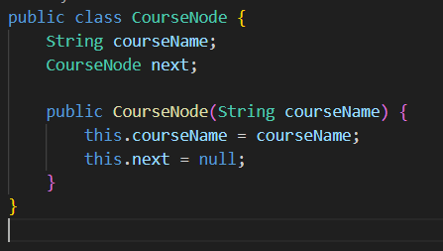
Course & Admission Operations
Course Registration
Admission Queue
Students can enroll in multiple courses through the addCourse() method. The system maintains a course catalog that displays all available options with sequential numbering.
Prospective students join an array-based queue via applyAdmission(). The admitStudent() method processes the queue in FIFO order, converting applicants to enrolled students.

Slide 7
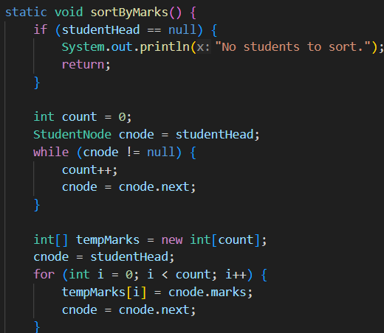
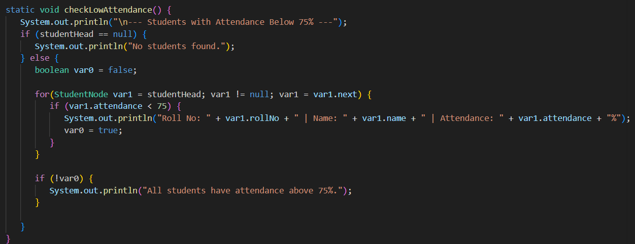
Sorting & Analytics
Merge Sort for Marks
Divide-and-conquer algorithm recursively splits the list, sorts sublists, then merges them back together. Produces sorted list with highest and lowest marks clearly identified.
Quick Sort for Attendance
Efficient in-place sorting using a pivot element and partitioning logic. Places attendance percentages in order, enabling quick identification of performance trends.
]

Slide 8
Conclusion
This college management system provides a complete foundation for learning Java data structures and application architecture. The modular design makes it easy to extend with additional features like grade calculations, course prerequisites, or advanced reporting.

